Slide 1



Slide 2





Structure the final presentation in PPT format, following a logical order
Report Preparation and final Submission
0
Final Presentation & Report Preparation
Group Details – Team members and roles.
Project Summary – Brief overview of objectives and impact.
KPI List – Key performance indicators and their business relevance.
Excel Dashboard – Initial findings and data trends.
Tableau Dashboard – Interactive visualizations and insights.
Power BI Dashboard – Advanced analytics and performance tracking.
SQL Query Image – Schema and queries used for data transformation.
Key Takeaways – Business insights, challenges, and future recommendations
2

Slide 3
Project Summary
Objectives and Impact: The main objective of the project was to create a dashboard that tracks key hotel metrics like revenue, occupancy, and bookings. This helped hotel teams access real-time insights, reduce manual reporting, and make better business decisions. The impact was improved efficiency, more accurate tracking, and smarter planning across all hotel locations.

Slide 4
KPI List
Total Revenue
Occupancy Rate
Cancellation Rate
Total Bookings
Utilized Capacity
Booking Trends
Revenue by Room Category
Weekday vs. Weekend Performance
Revenue by State/Location
Check-out / Cancel / No-show Status

Slide 5
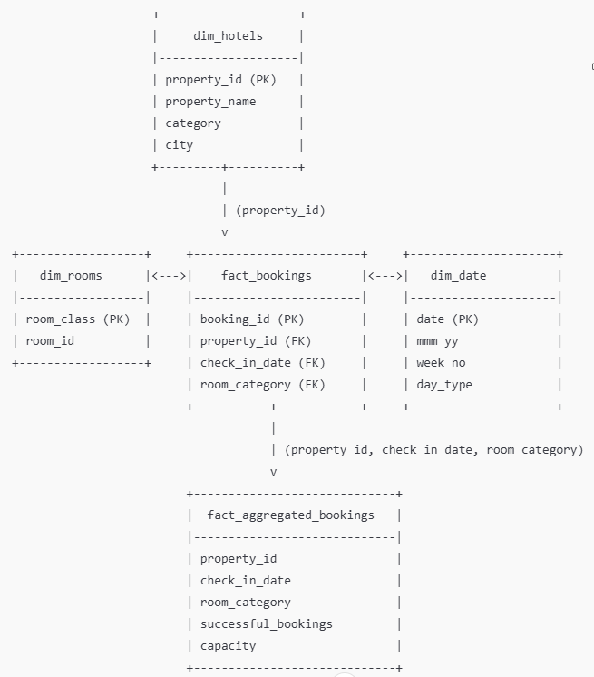
Hospitality Data Model

Slide 6
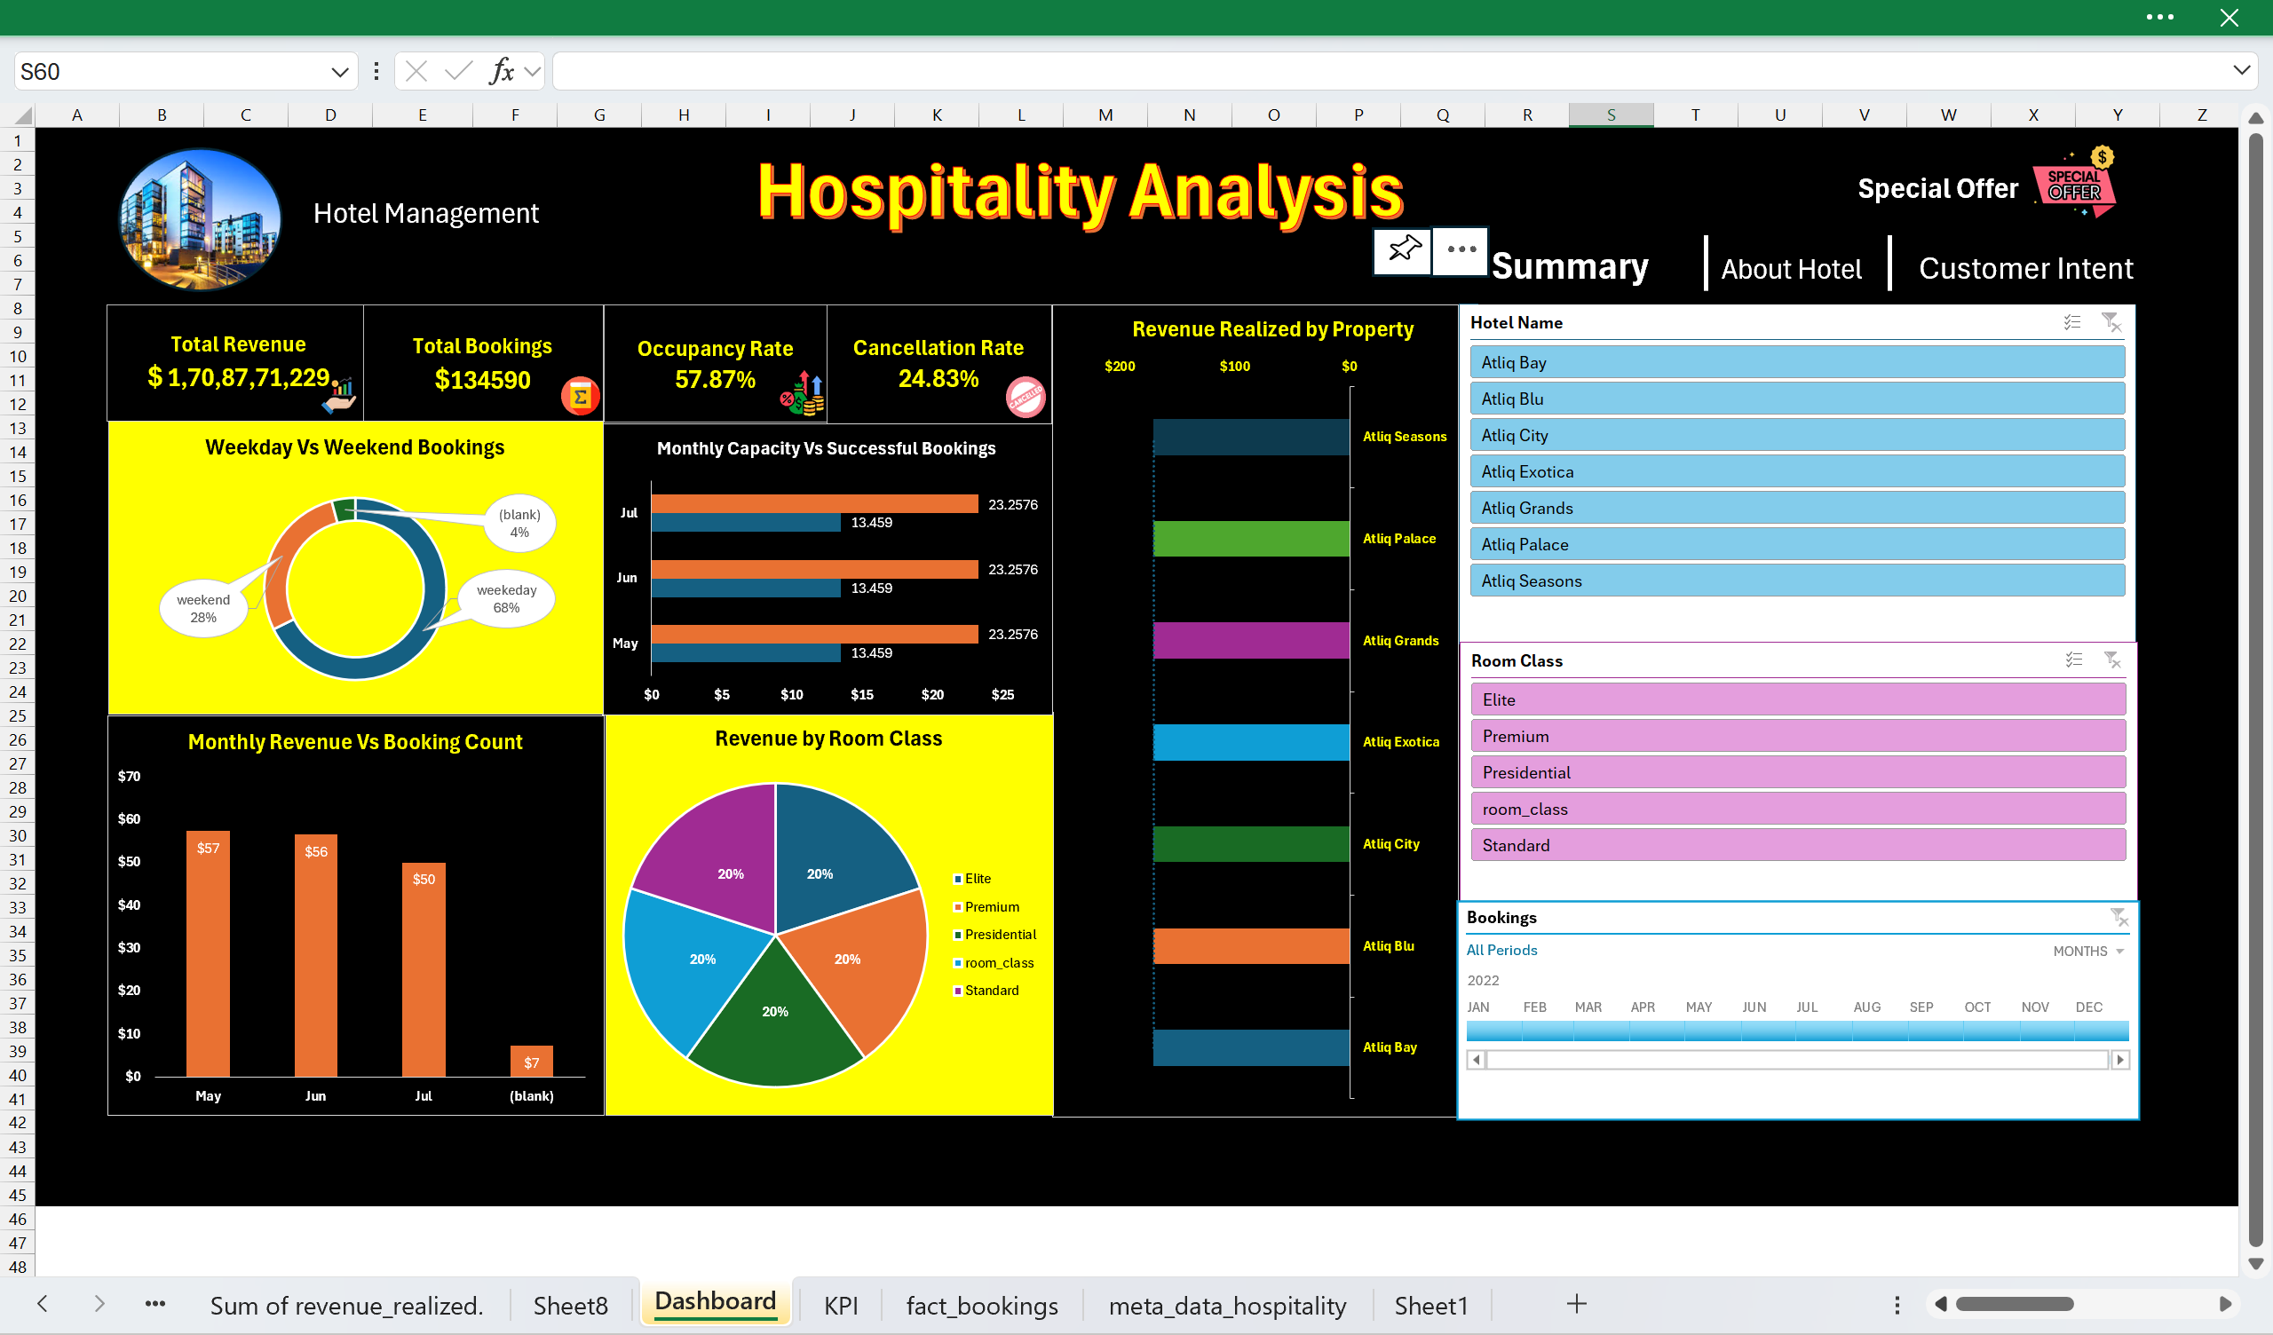
Excel Dashboard
Hospitality Dashboard: $1.7B Total Revenue, 134K Bookings, 57.87% Occupancy, 24.83% Cancellation Rate, 68% Weekday Bookings, top revenue property Atiq Palace.

Slide 7
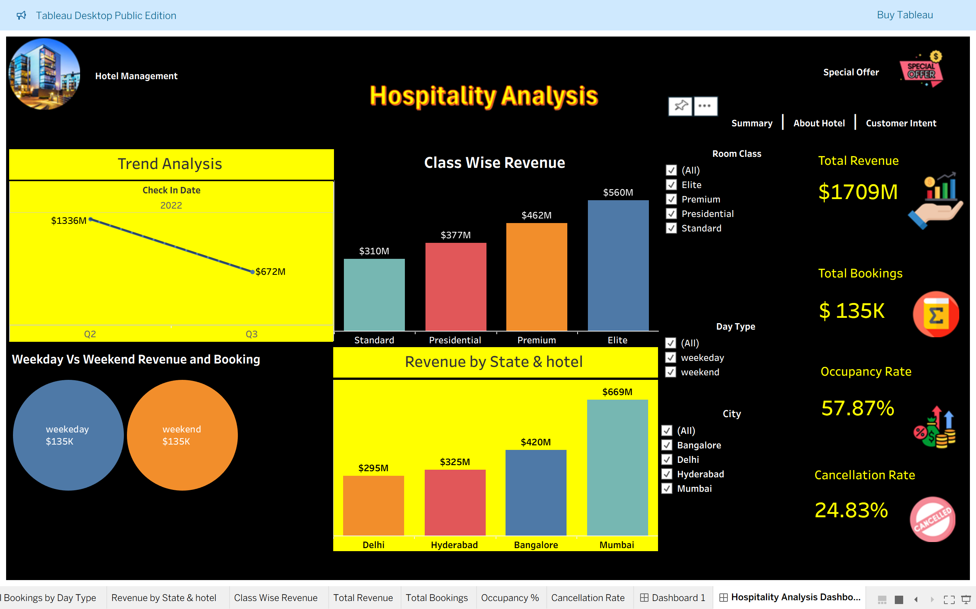
Hospitality Dashboard: Shows $1709M Total Revenue, 135K Total Bookings, 57.87% Occupancy Rate, 24.83% Cancellation Rate, Top State Mumbai ($669M), Top Class Elite ($560M).
Tableau Dashboard

Slide 8
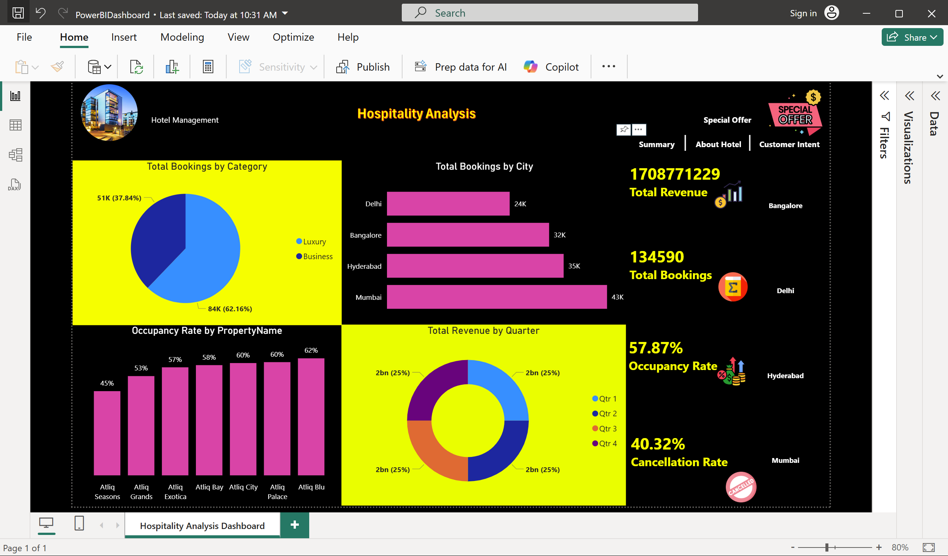
Power BI Dashboard
Hospitality Dashboard: Tracks $1.7B Total Revenue, 134.5K Total Bookings, 57.87% Occupancy Rate, 40.32% Cancellation Rate, 62% Top Occupancy (Atiq Blu), 62% Business Bookings (84K).

Slide 9
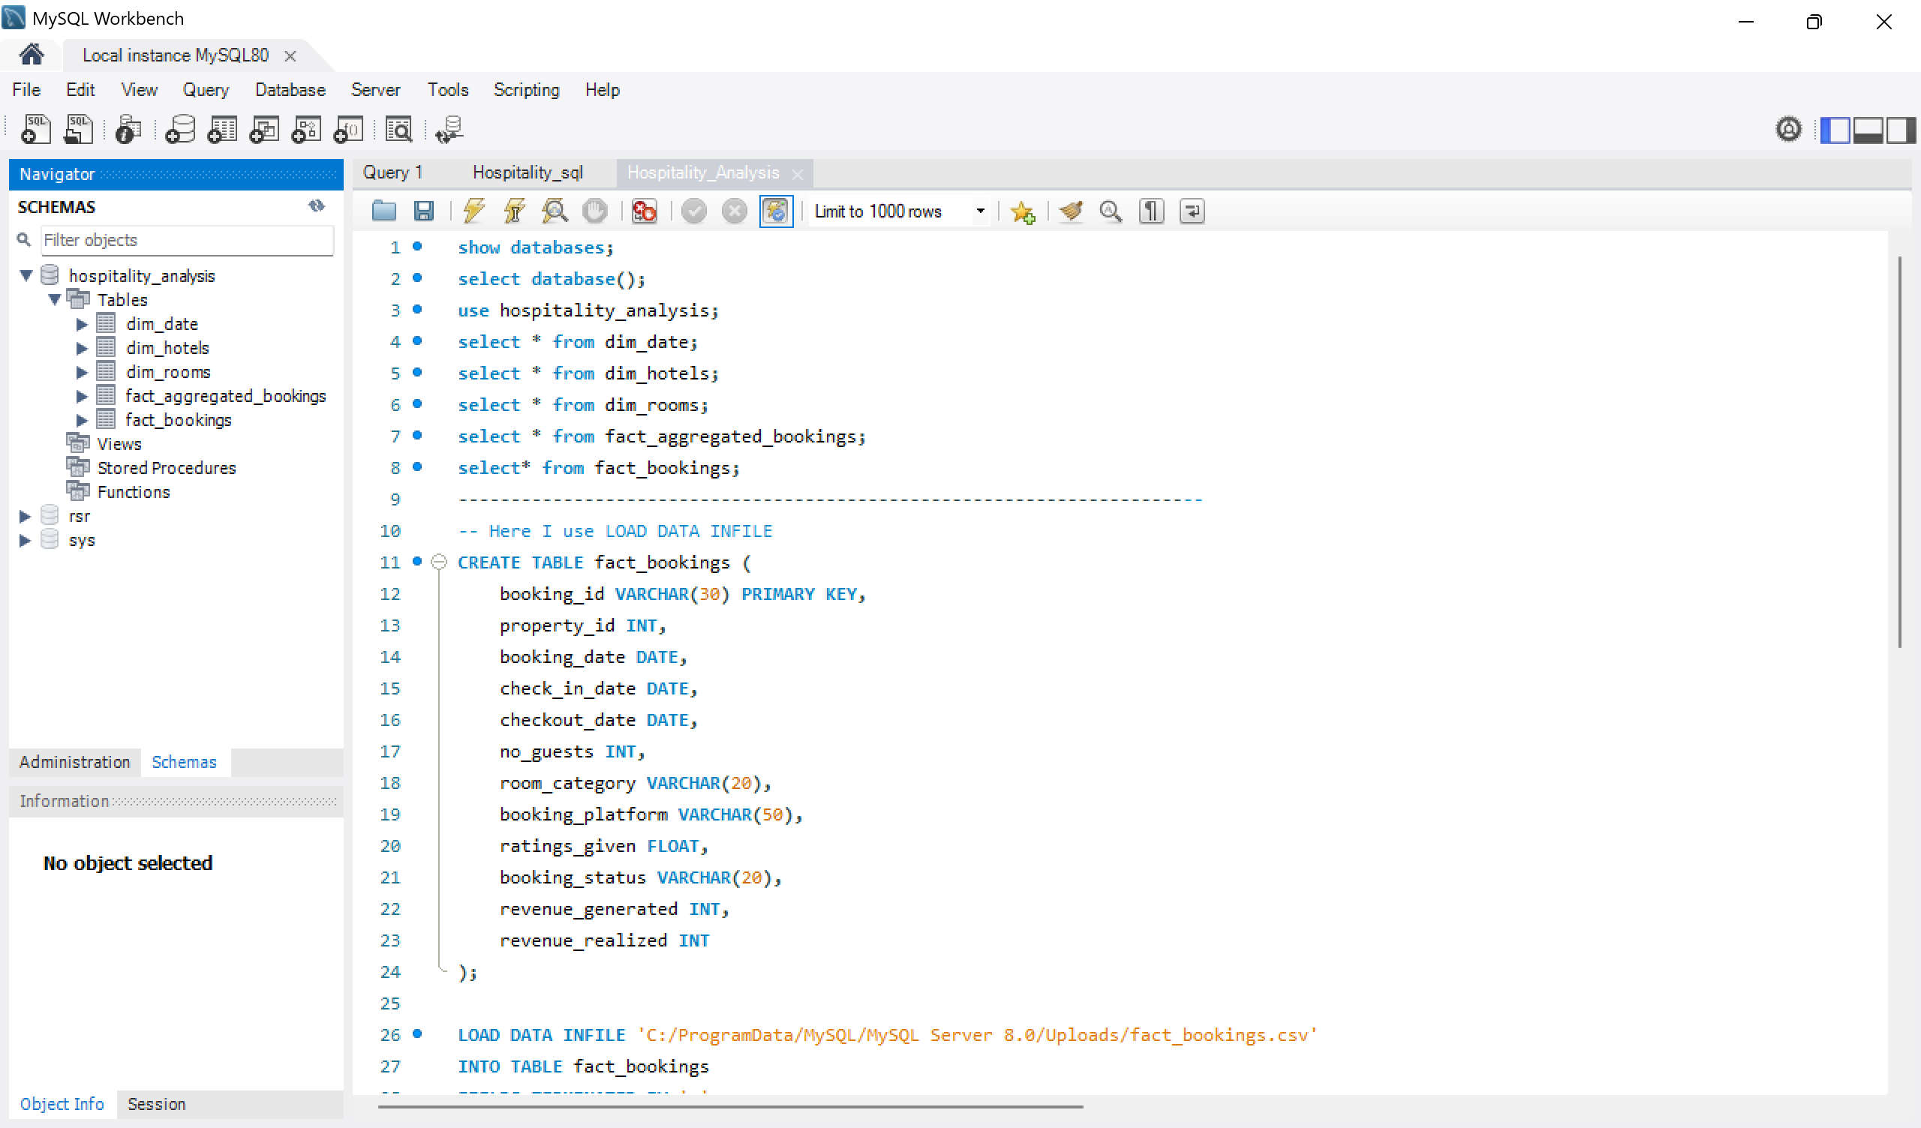
SQL Query Image

Slide 10
Key Takeaways
Key Takeaways
Business Insights: With 134.5K bookings and $1,709M in total revenue, hotel performance remains strong across major cities and room categories (as of 10:31 AM IST, July 23, 2025).
Challenges: Managing high cancellation rates (40.32%) and balancing weekday/weekend occupancy pose ongoing operational challenges.
Future Recommendations: Integrate customer loyalty analysis, forecast seasonal demand, and enhance real-time occupancy and revenue dashboards.

Slide 11


